Slide 1

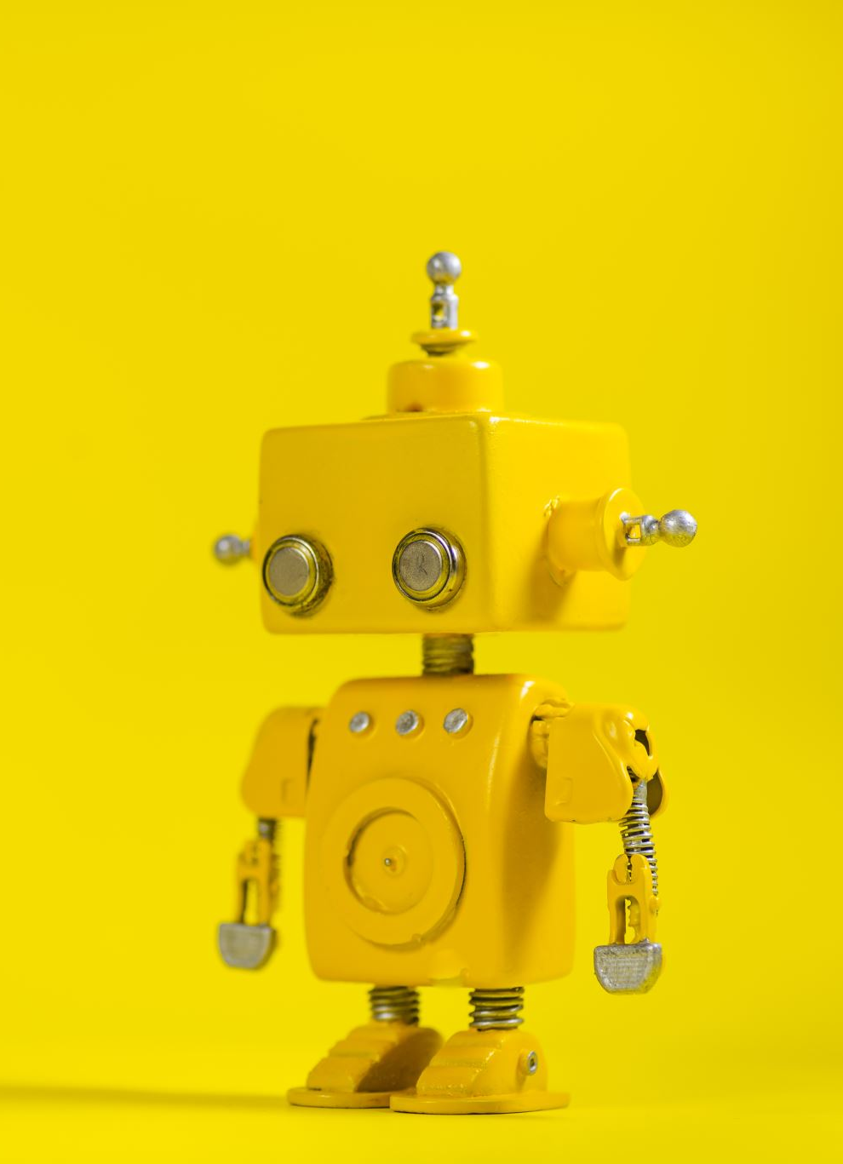

Imitation Learning for Skill Transfer in Human-Robot Teleoperation
Group 11
Marco Schouten (5352908)
Chenghao Xu (5266068)
Supervisor:
R Venkatesha Prasad
Vineet Gokhale
Ashutosh Simha

Slide 2
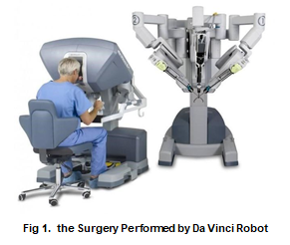
Project Background
Robotic intelligence for specific skills
→ Imitation Learning
Rapid development of 5G technology
→ Teleoperation
Applications:
Service Robot; Biped Robot; Surgery Robot;

Slide 3
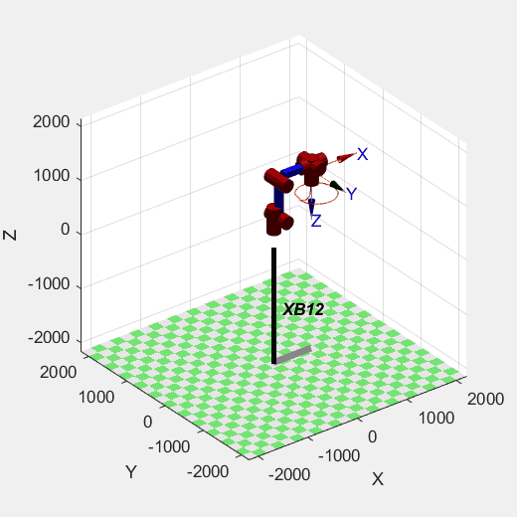

Motivation
Main Problem:​
Transmission time delay​
Transmission data size
Control interval: 1 ms = 0.001 s
Number of control input: 6
Reproduce the trajectory in the past 1 s:
6000 float number data
+ force data & torque data

Slide 4




Setup

Slide 5
Project Requirements
Learn the trajectories
Minimal inputs

Slide 6

Ethical and societal implications
Normative Ethics
Consequentialism
Deontology
Virtue Ethics

Slide 7
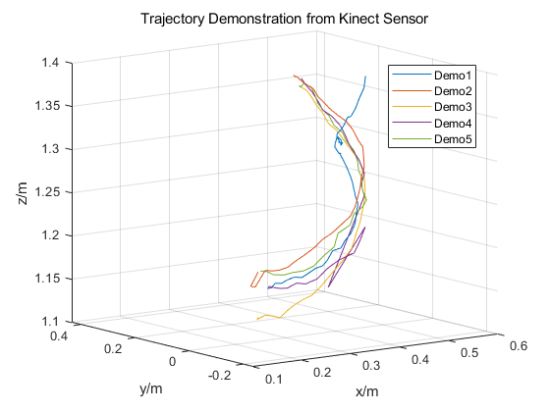
Design

Slide 8
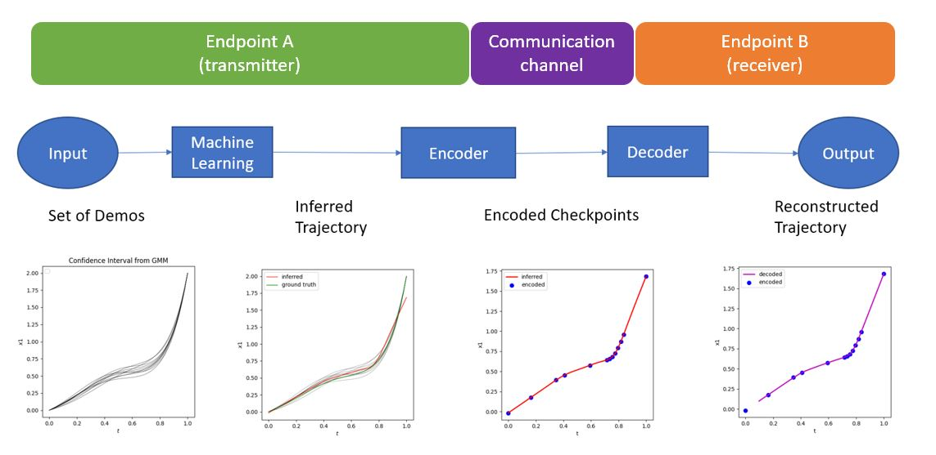
Design

Slide 9
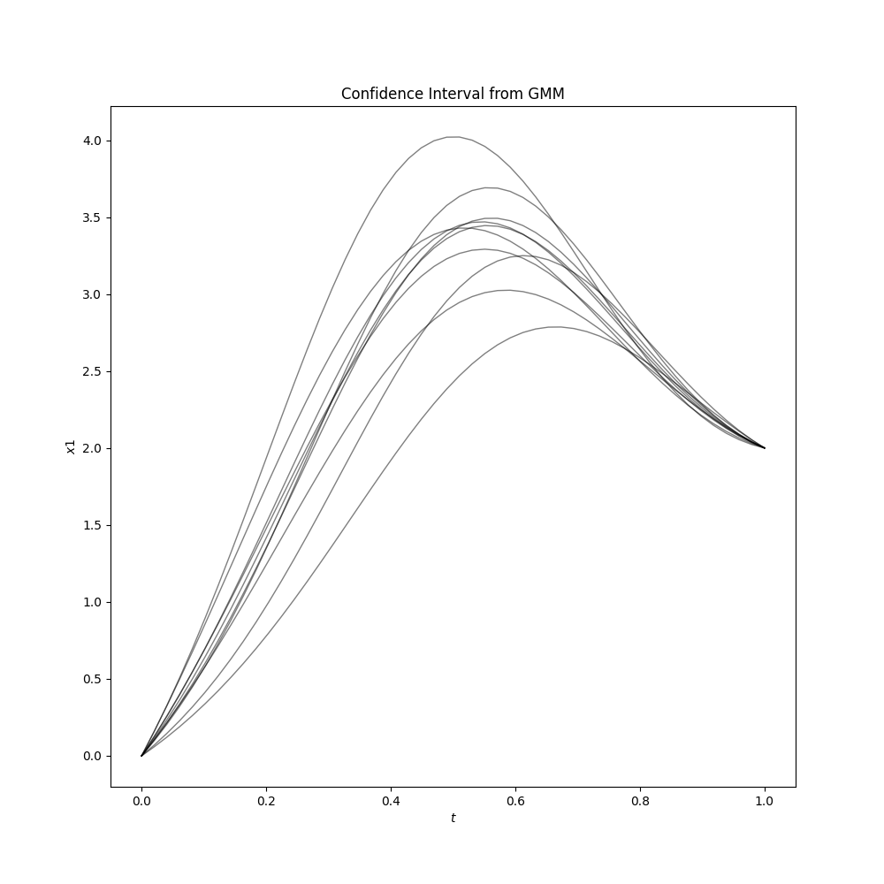
Demos

Slide 10
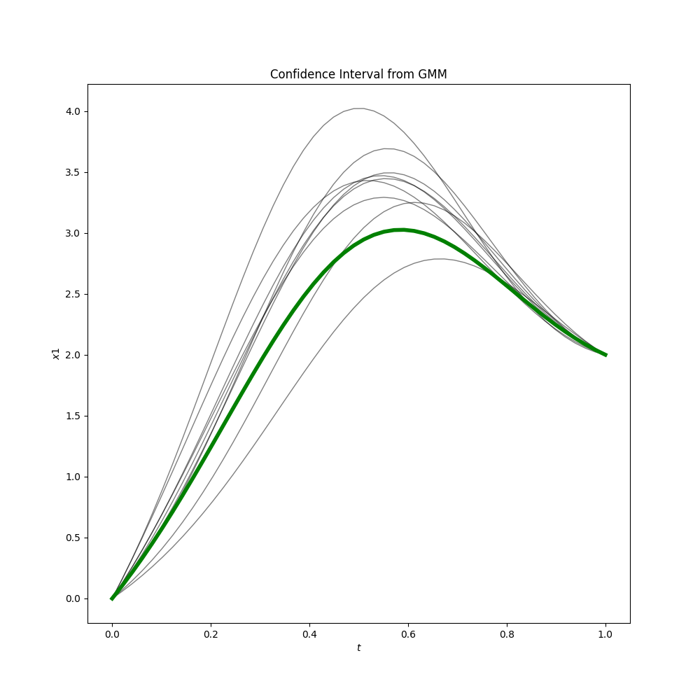
Ground Truth

Slide 11
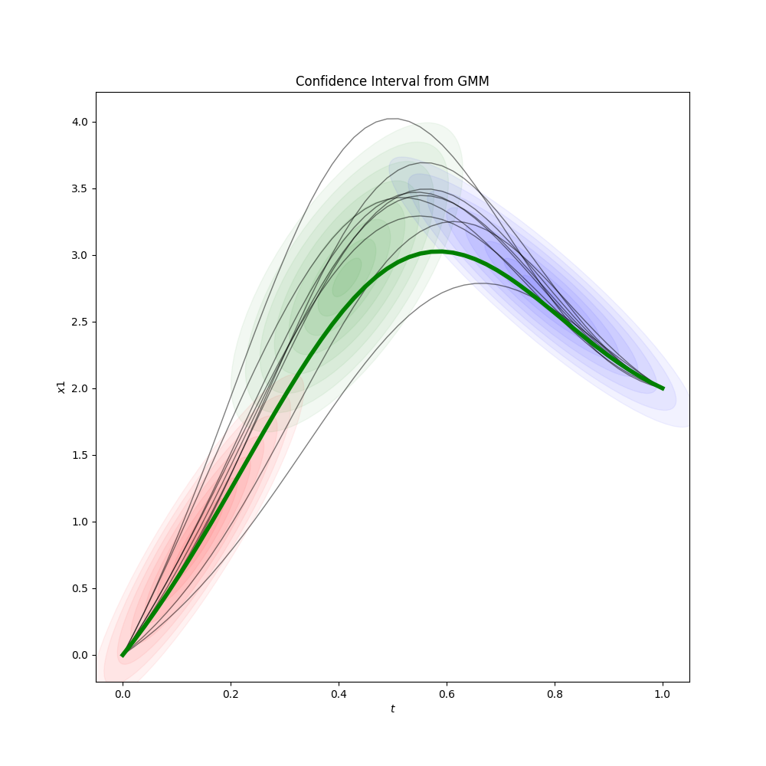
Gaussians Components

Slide 12
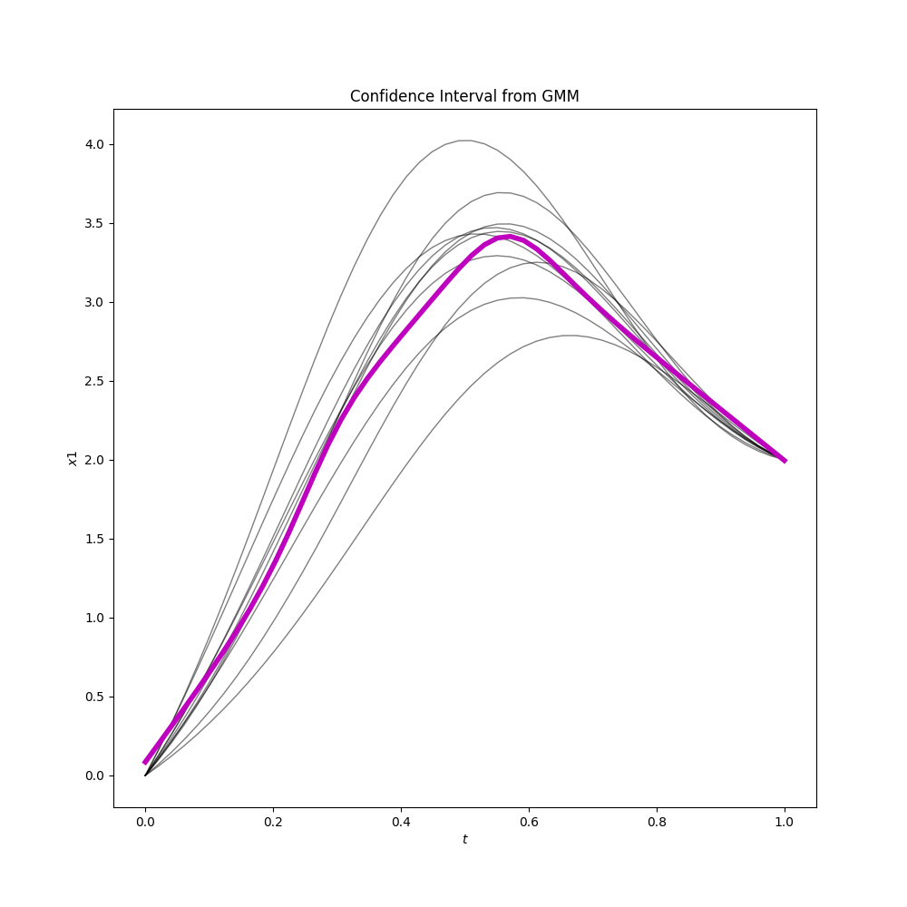
Inference

Slide 13
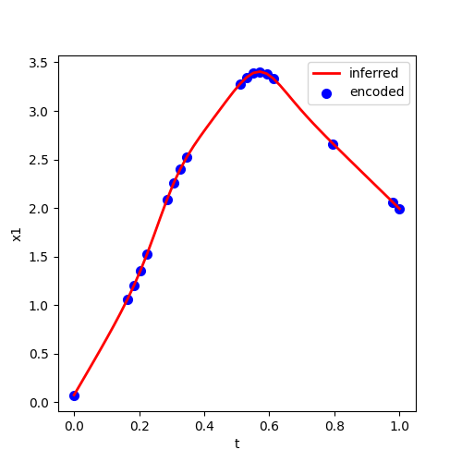
Encoder Reduced datapoints by 64%

Slide 14
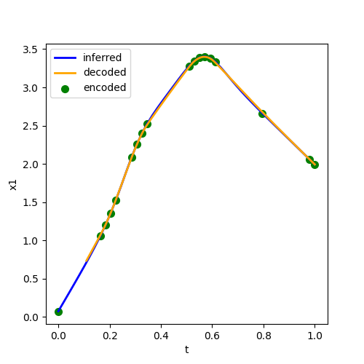
Decoder

Slide 15
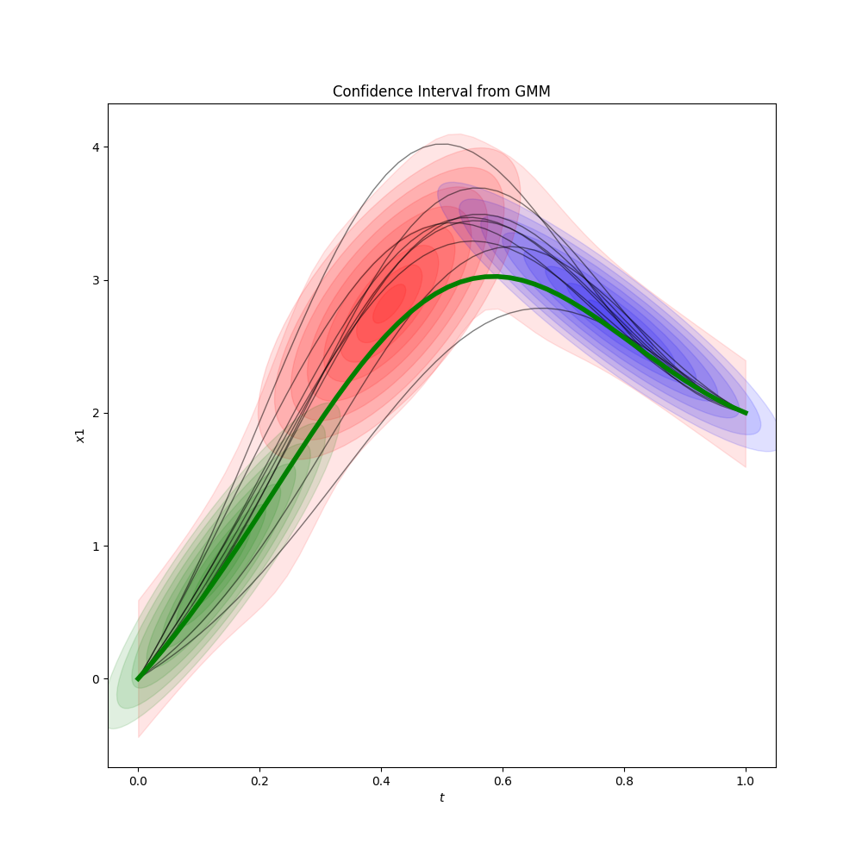
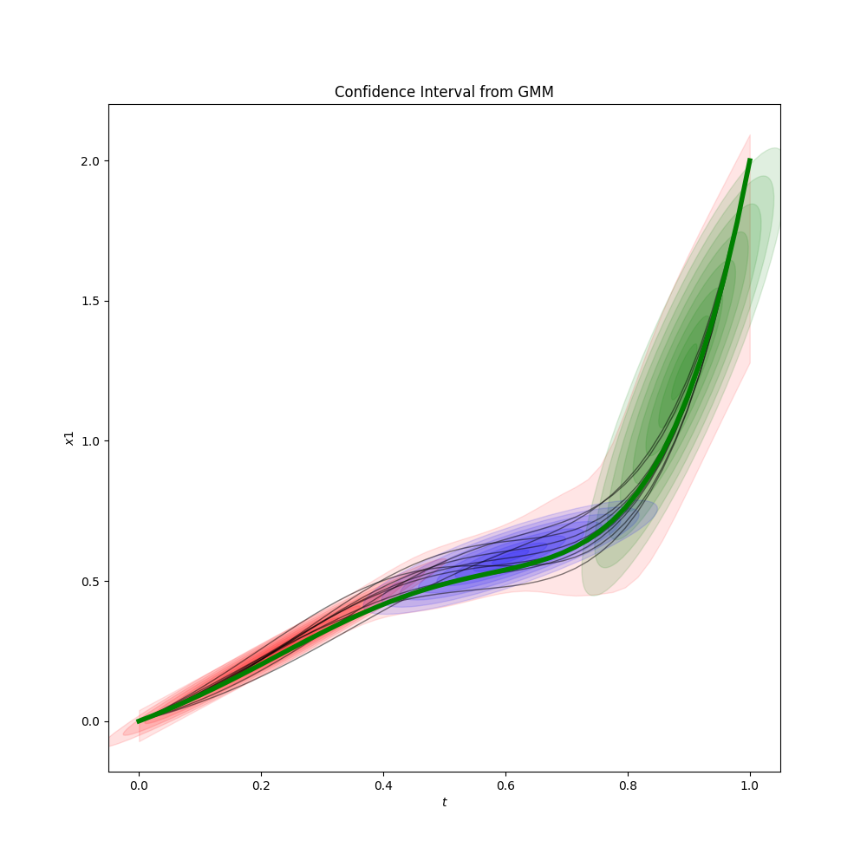
Tasks Dictionary
Task A
Task B

Slide 16
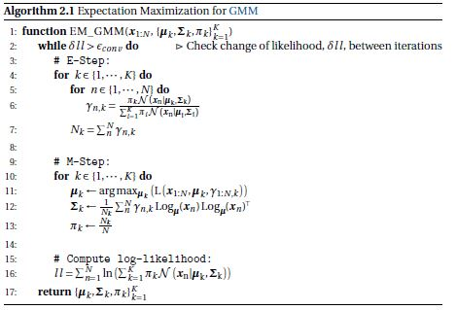
EM Algorithm

Slide 17
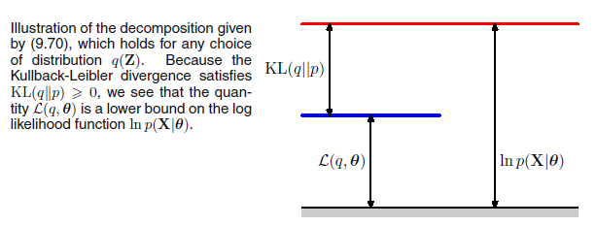
EM decomposition

Slide 18
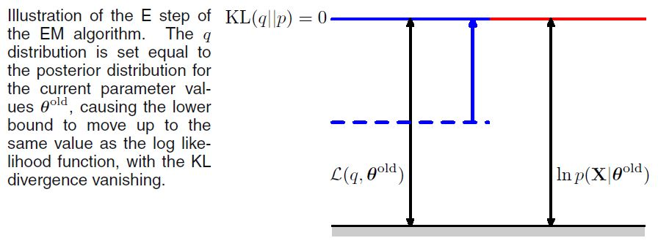
E step

Slide 19
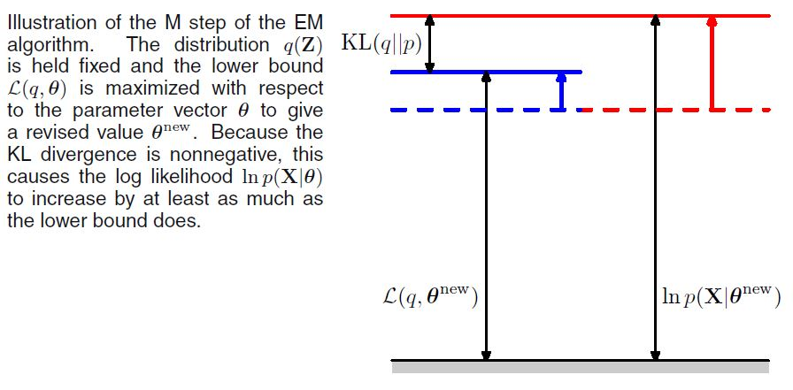
M Step

Slide 20
Evaluation
Mean Square Error
r2
Mean Absolute Error

Slide 21
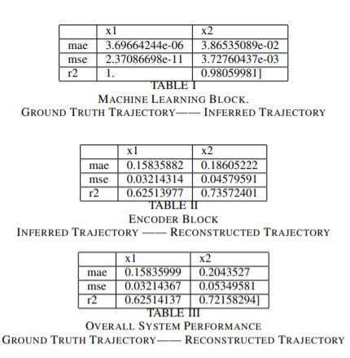
Results

Slide 22
Limitations
Does not Include
force
Orientation
Acceleration

Slide 23
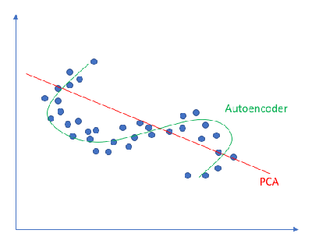
Limitations
Simple dim reduction algorithm do not work
Space is highly nonlinear

Slide 24
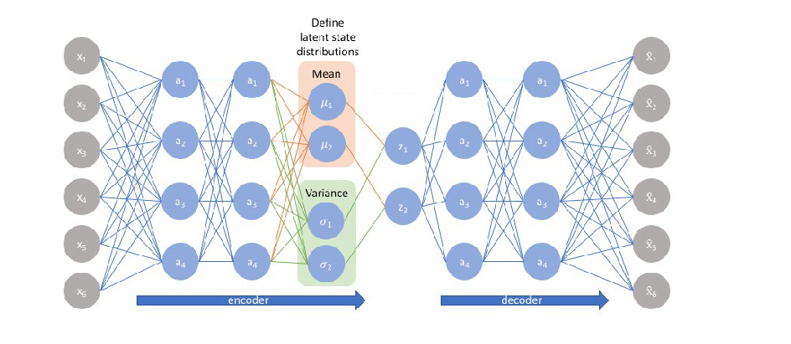
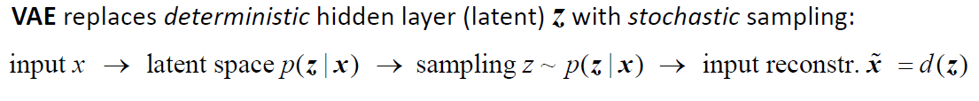
Limitations
Variational Auto Encoders

Slide 25
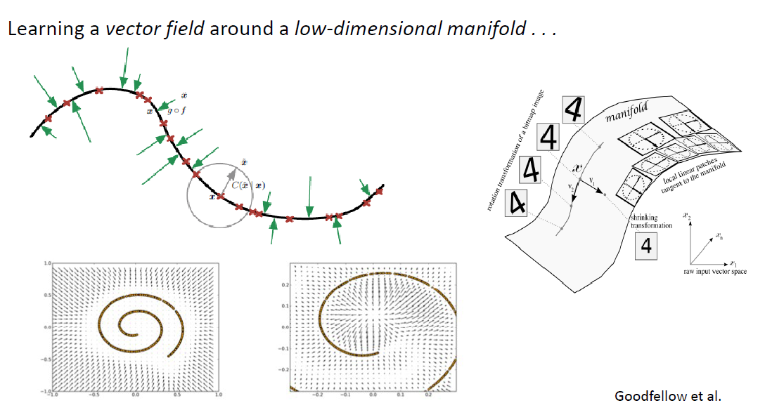
Limitations

Slide 26
Future Work
Variational Auto Encoder (deep generative models)
Bayesian Modelling for Prior for Task trajectory
Non-Euclidean Spaces

Slide 27
Wider Implications
Assisted Surgery
Constructions in Extreme Environments

Slide 28
Thank you for your attention

